Slide 1

IOT based smart wearable safety gadget
Group-7
Amandeep Kaur(748434)

Slide 2
Interfacing of ESP32-CAM with LPC2148

Slide 3
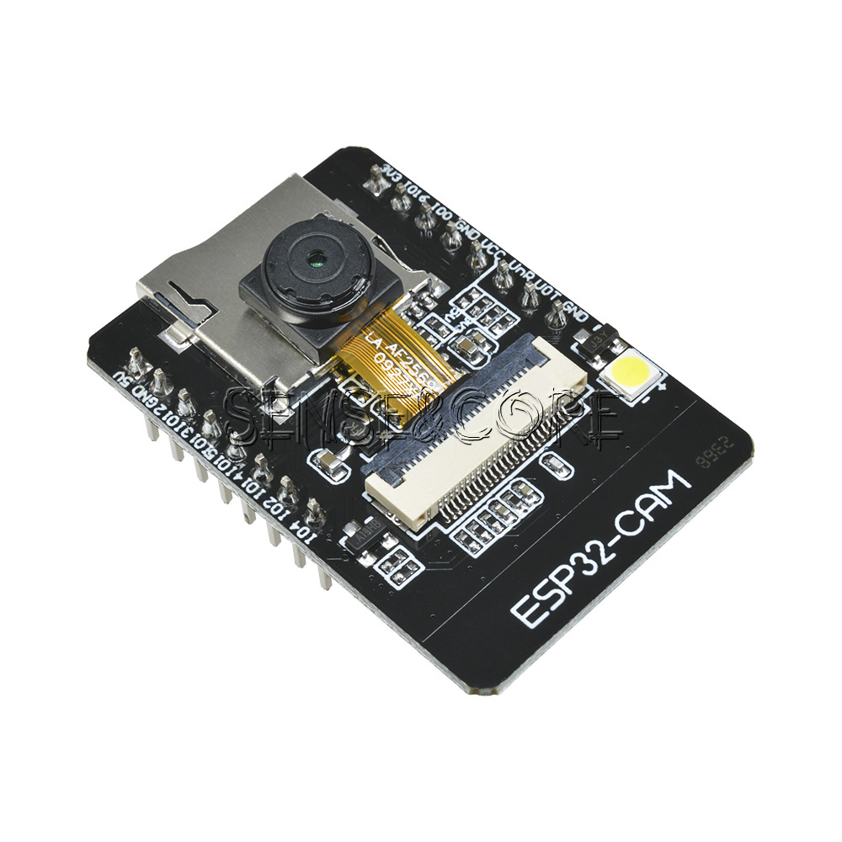
ESP32-CAM
Small camera module.
Integrated micro SD card socket.
Cost effective.
Nine GPIO pins.
Flash LED.

Slide 4
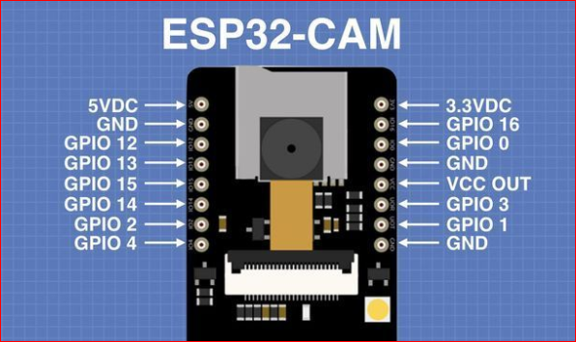
Pin diagram of Esp32-cam

Slide 5
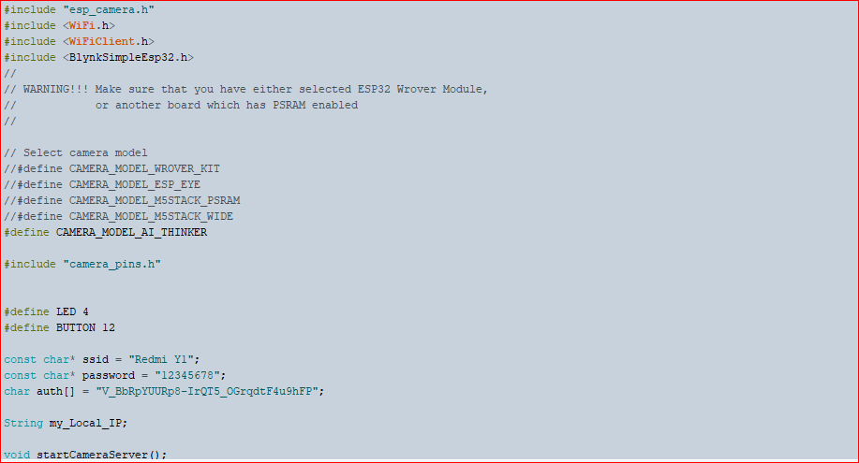

Slide 6
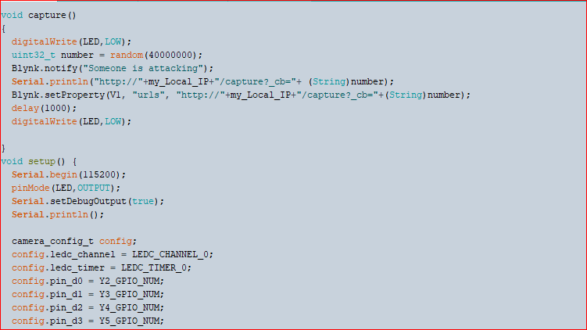

Slide 7
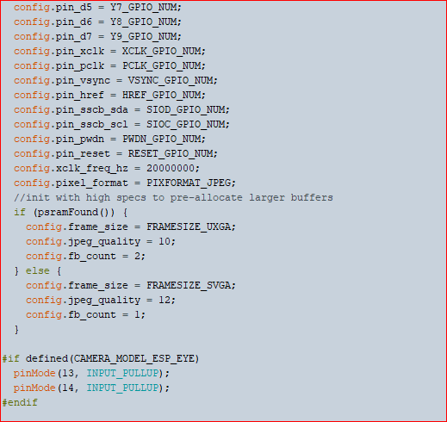

Slide 8
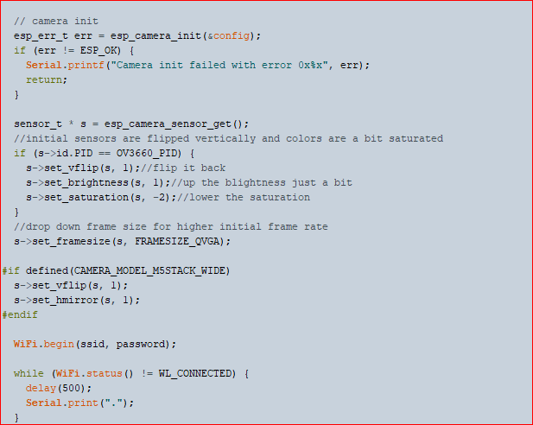

Slide 9
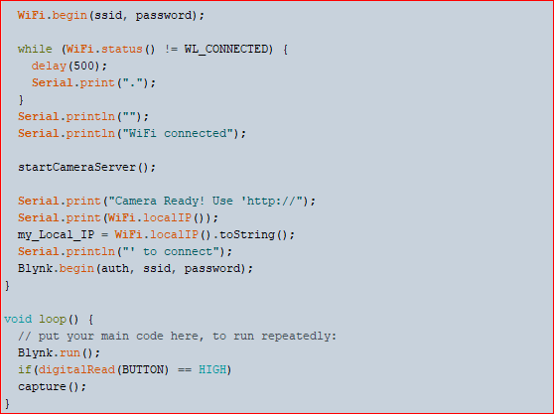

Slide 10
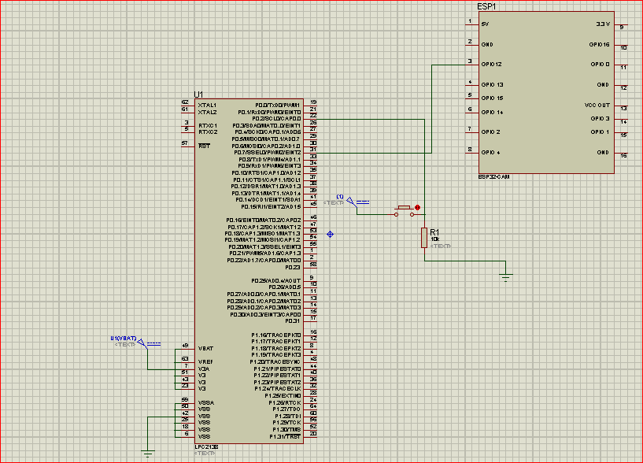
Schematic Design

Slide 11
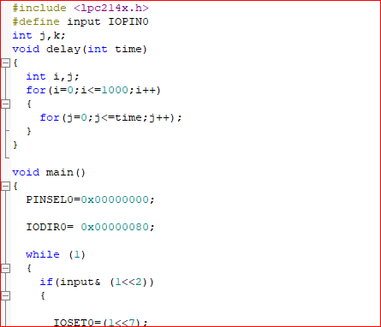
Coding

Slide 12
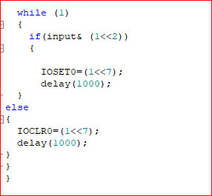

Slide 13
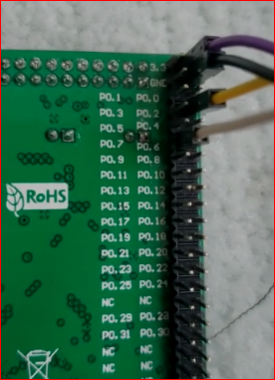
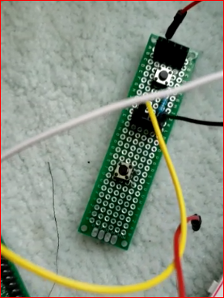
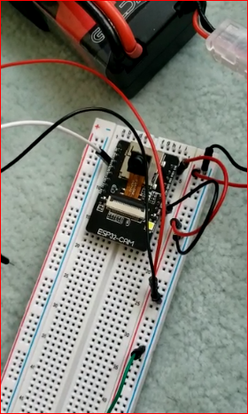
Hardware implementation

Slide 14
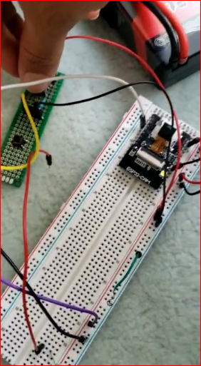
Results

Slide 15
Reference
Dronebot Workshop(2020).Getting started with ESP32-CAM. https://dronebotworkshop.com/esp32-cam-intro/
Tejonidhi.M.R.,Dyana. M.K.Aishwarya, Nagamma.H., Chaithara.K.S. (2019),IOT based smart secuirty gadget for women’s safety, International Conference on Advance in Information Technology. https://ieeexplore.ieee.org/document/8987242

